Slide 1
CPU vs GPU
Rosetta ML Bootcamp
Ian Anderson
Adapted from Nick Randolph’s 2024

Slide 2
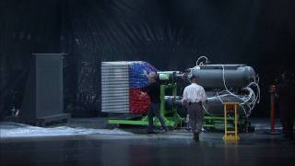

Slide 3
High level differences
Central Processing Unit (CPU)
Backbone of computing since 1970s
Graphics Processing Unit (GPU)
Developed for visual rendering and computer graphics

Slide 4
High level differences
Central Processing Unit (CPU)
Backbone of computing since 1970s
Comprised of several complex cores (~10¹), each with memory for caching data for rapid access
Graphics Processing Unit (GPU)
Developed for visual rendering and computer graphics
Comprised of many simple cores (~10³) that share memory

Slide 5
High level differences
Central Processing Unit (CPU)
Backbone of computing since 1970s
Comprised of several complex cores (~10¹), each with memory for caching data for rapid access
Optimized for intractability, flexibility, and performing complex tasks sequentially with low latency
Graphics Processing Unit (GPU)
Developed for visual rendering and computer graphics
Comprised of many simple cores (~10³) that share memory
Optimized for performing many simple, compute-intensive tasks all at once (in parallel) but comes at cost of higher latency

Slide 6
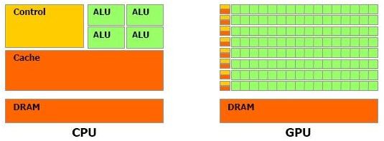
Visualizing CPUs and GPUs
ALU = arithmetic logic unit
DRAM = dynamic random-access memory

Slide 7
Visualizing CPUs and GPUs
ALU = arithmetic logic unit
DRAM = dynamic random-access memory

Slide 8
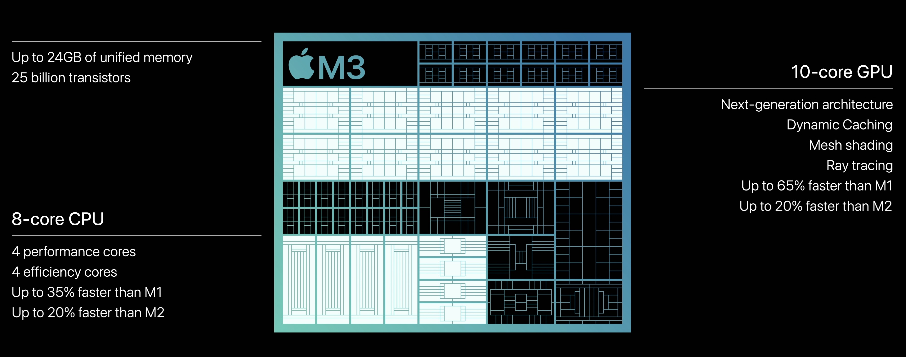
Wait... Apple is advertising 10 GPU Cores?

Slide 9
Hands-On Activity

